Slide 1
TOURIST ATTRACTIONS OF OUR REGION LITHUANIA Zypliai manor and Cultural Heritage

Slide 2
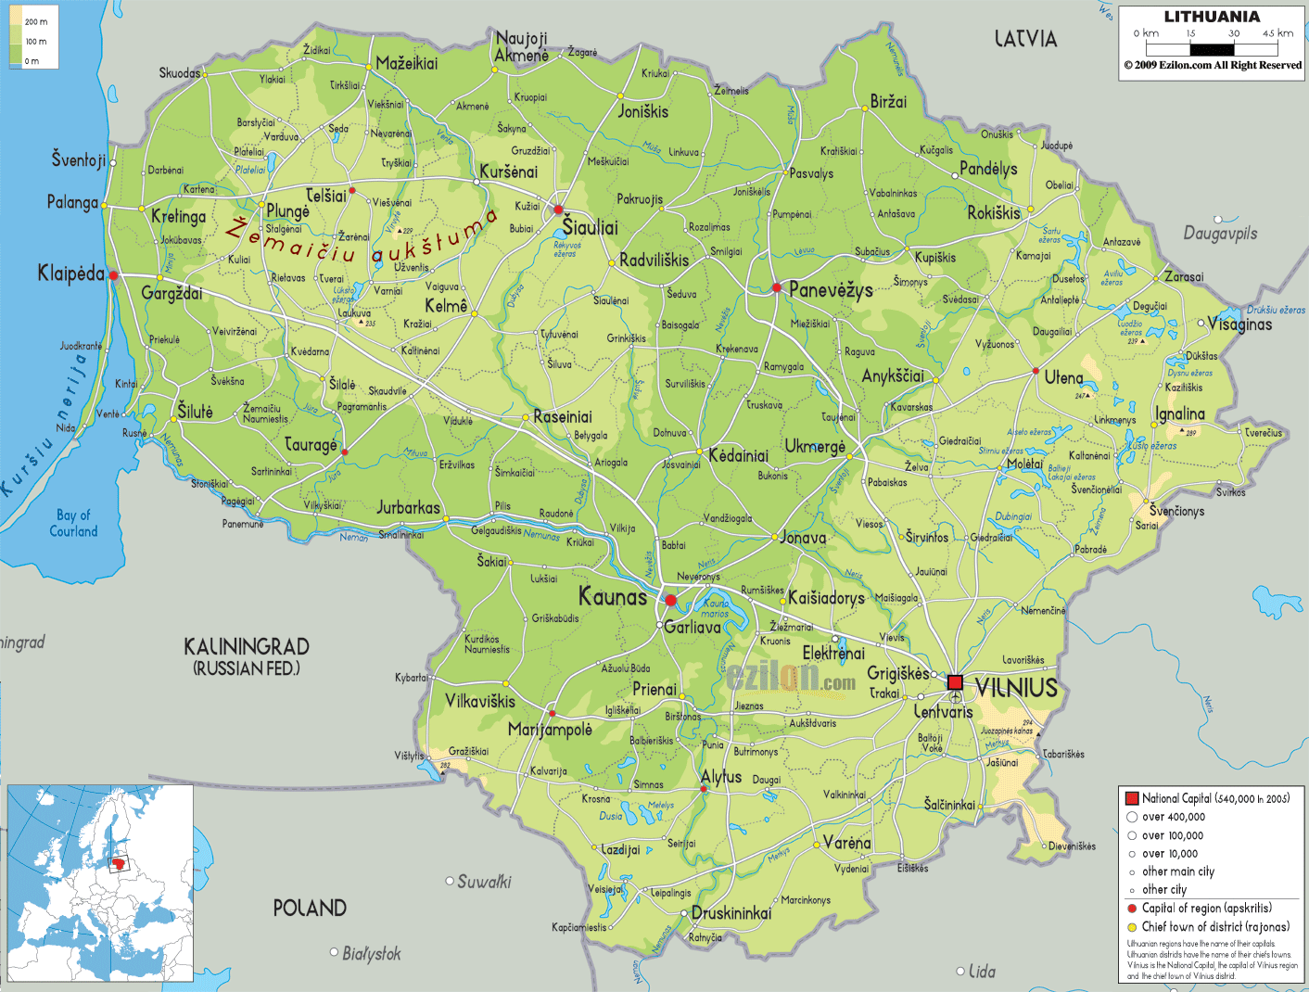
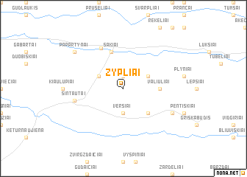
Lithuania Zypliai
LOCATION
https://www.ezilon.com/maps/europe/lithuania-physical-maps.html
https://nona.net/features/map/placedetail.853132/Zypliai/

Slide 3
Lithuania
Manor house of Zypliai
TYPE OF SITE
Architectural, naturalistic, museum
PHYSICAL AND AESTHETIC FEATURES
Ensemble of Zypliai manor estate is composed of 13 buildings: mansion, two houses of servants, cow house, stables, barn, coach house, kennel and others. The estate is surrounded by the park which is one of the oldest in Lithuania.
AREA COVERED
The manor is surronded by park which is one of the largest in Lithuania and occupies 21 hectares.
HISTORICAL/SCIENTIFIC/ARTISTIC INFORMATION
The story of estate begins from old Zypliai manor, which was the property of the Grand Duke of Lithuania, and since 1807 devolve to duke Juozapas Poniatovskis, who got it for his merits in the war with Napoleon's army.
Zypliai Manor is one of the youngest manors in Lithuania. His story is just 200 years old.
DATING
Zypliai manor ensemble established in the mid-nineteenth century

Slide 4
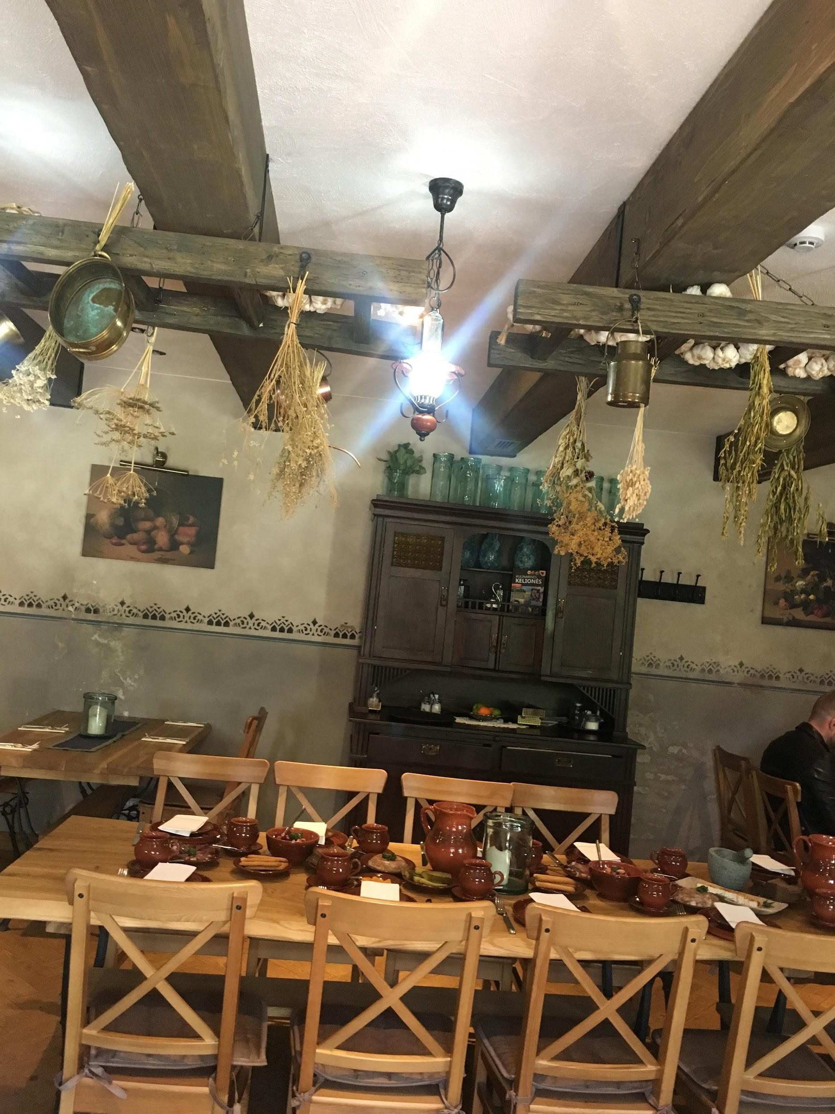
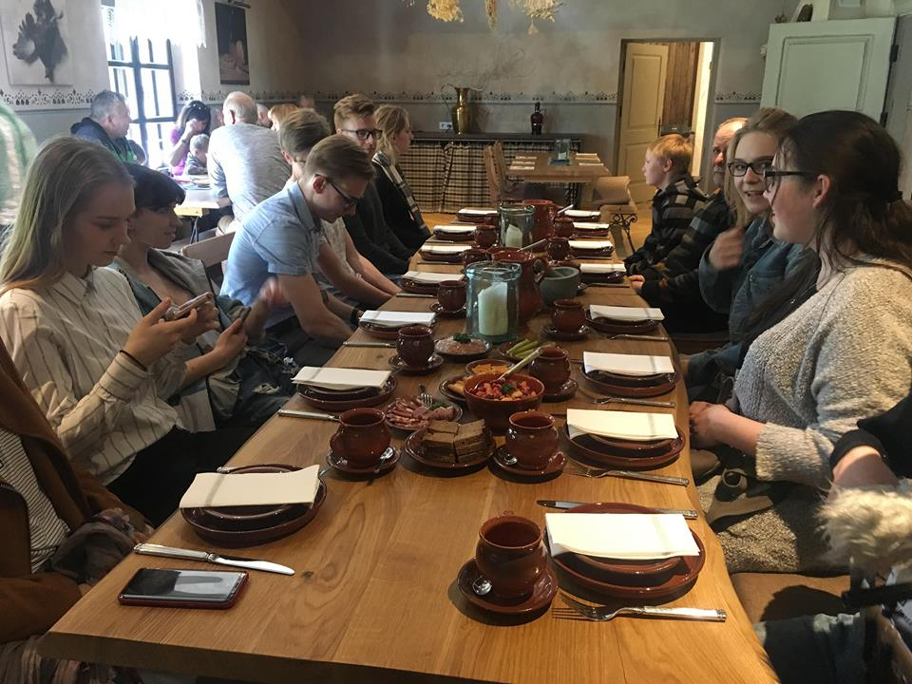
REGION NAME Lithuania
The restaurant “Kuchmistrai“ Cultural heritage
The restaurant “Kuchmistrai”, located in the restored kitchen of the manor, offers a range of manor dishes prepared according to the traditions of the Lithuanian Grand Duchy “kuchmisters” (chefs). You will be able to enjoy undiscovered tastes there. Those who do not have much time but still want to try as much as possible, may order three types of tasting or an educational program “Zanavykų ragaučius“.

Slide 5
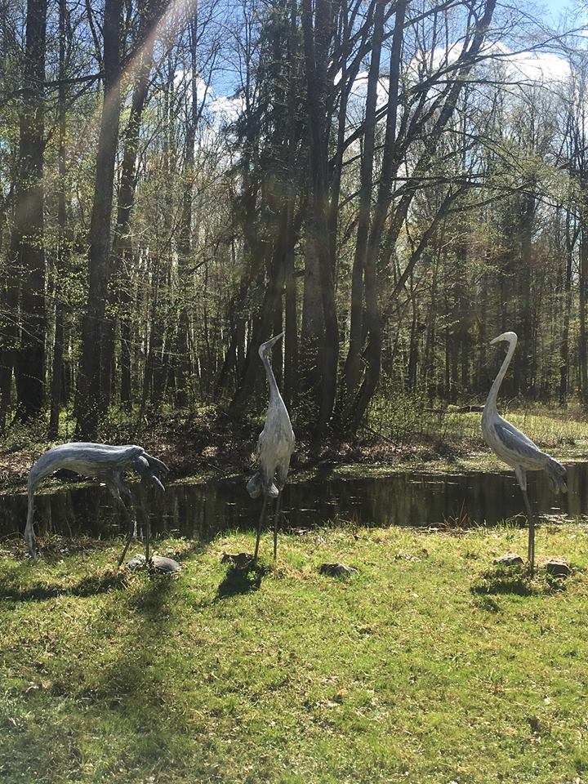
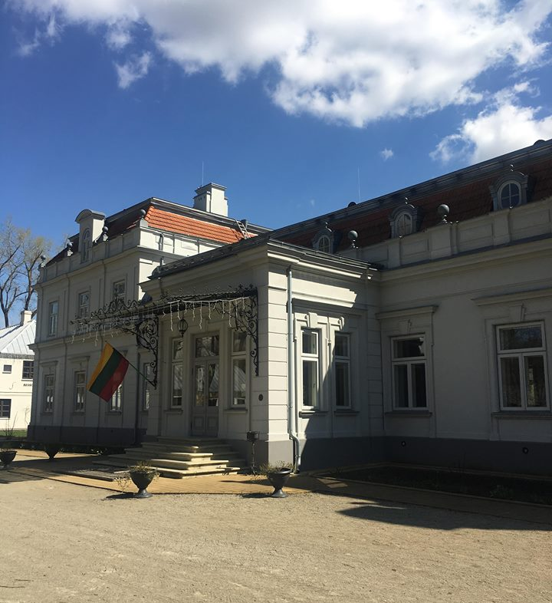
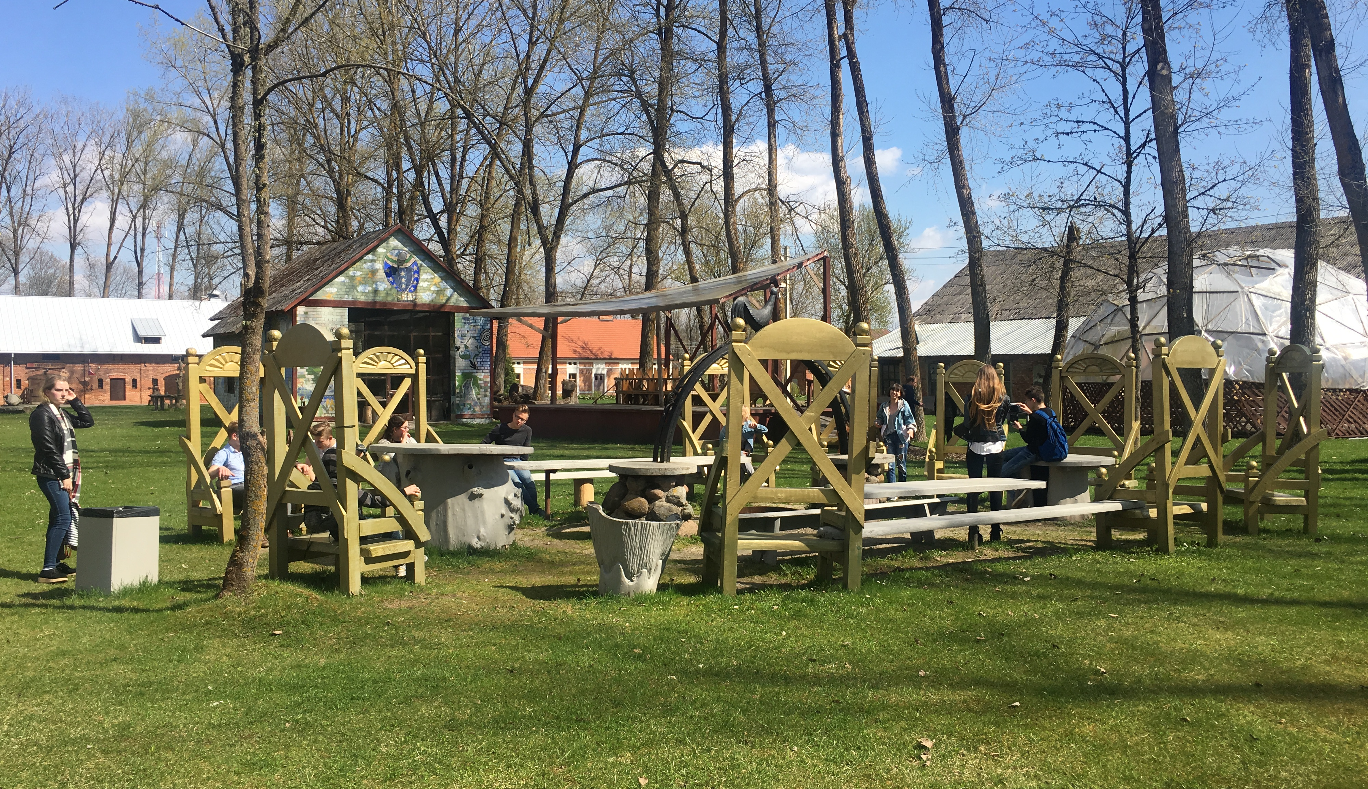
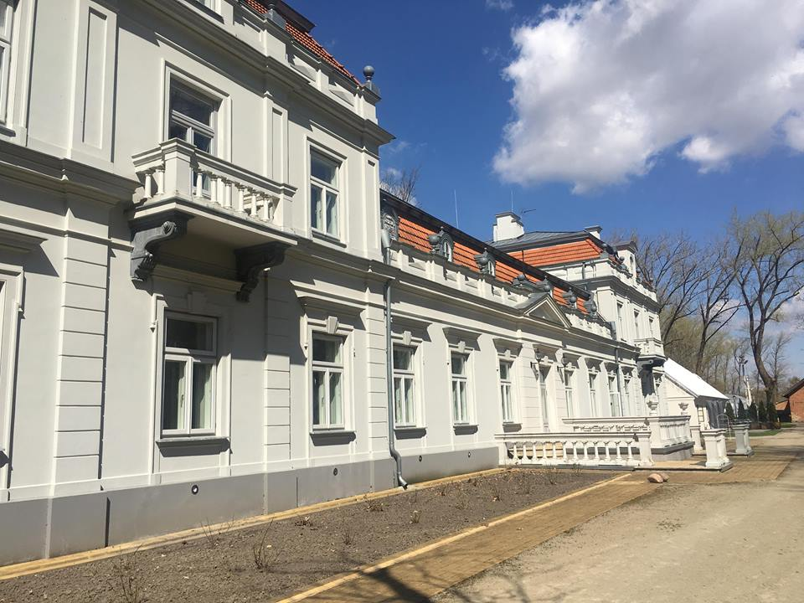
REGION NAME Lithuania
Zypliu Manor

Slide 6
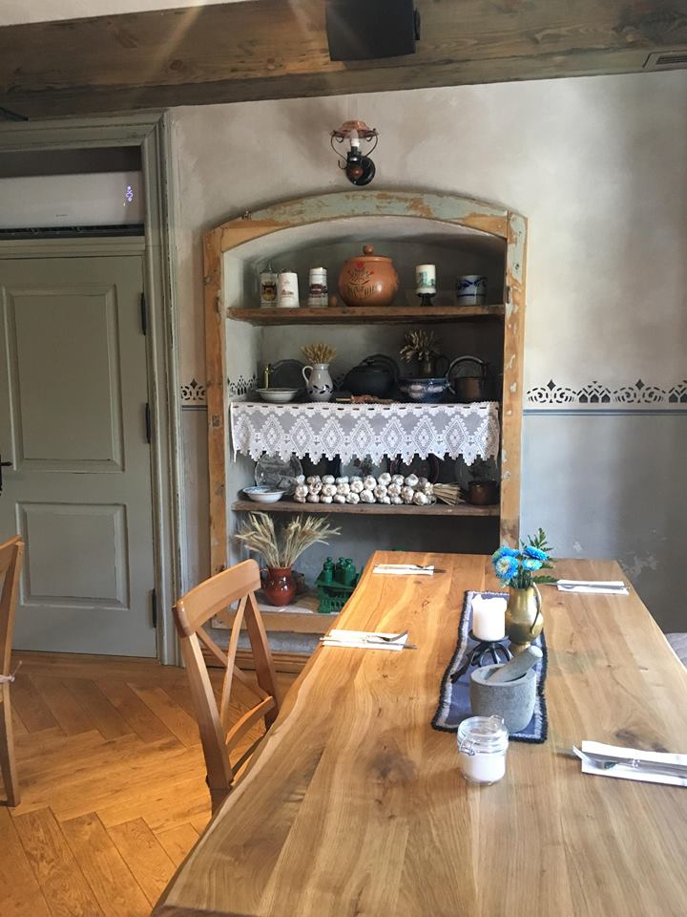
Lithuania Zypliu manor
VISITING TIME
CONDITION OF PRESERVATION
The management and reconstruction works began in 2002 and the major palaces restoration works were completed in 2012.
Works were funded by the Šakiai District municipality, Department of Cultural Heritage and the European Union funds.
Monday to Thursday - 9am to 5pm (lunch break 12-13 hours)
Friday - 9am to 4pm (lunch break 12-13 hours)
Saturday to Sunday is 10:00 to 16:00.
With a guide you can visit this area in 1h 30min
TICKETS AND BOOKING
The ticket with no guide
or adults 1€, for teens and seniors 0,5€ and for children its free.You can buy a ticket online or in the museum.

Slide 7
Lithuania Zyplių dvaras
ACCESSIBILITY
Zypliai manor is located in Zypliai village near a little town Lukšiai, 0.5 km from Kaunas-Šakiai road.
Programmes for disabled people are availlable. For the people who are suffering from blindness there is a description about everything in Braille. And for people who are deaf there is a special guide who tells everything in sign language.
FACILITIES
There are some hotels to stay and rural tourism accomodation clause to the area.
Cafes and restaurants are available in Sakiai as well as the restaurant with special menue next to the manor.

